Slide 1

Forklift Localisation
IIT Gandhinagar-Robotics
Aditi Singh | Monisha Kavuri

Slide 2
Problem Statement
To enable forklift operators to manually navigate environments without static obstacles, leveraging sensor data to ensure accurate localization and drift mitigation.
Testing localization algorithms on the TurtleBot 3 robot in both real-world and Gazebo simulation environments using ROS 2.

Slide 3
Sensor Fusion Approach
1: Using IMU sensor and ArUco Marker detection
2: Using IMU sensor, wheel encoders and ArUco Marker detection
Algorithms Used
1: Simple Bayes Filter
2: Kalman Filter

Slide 4
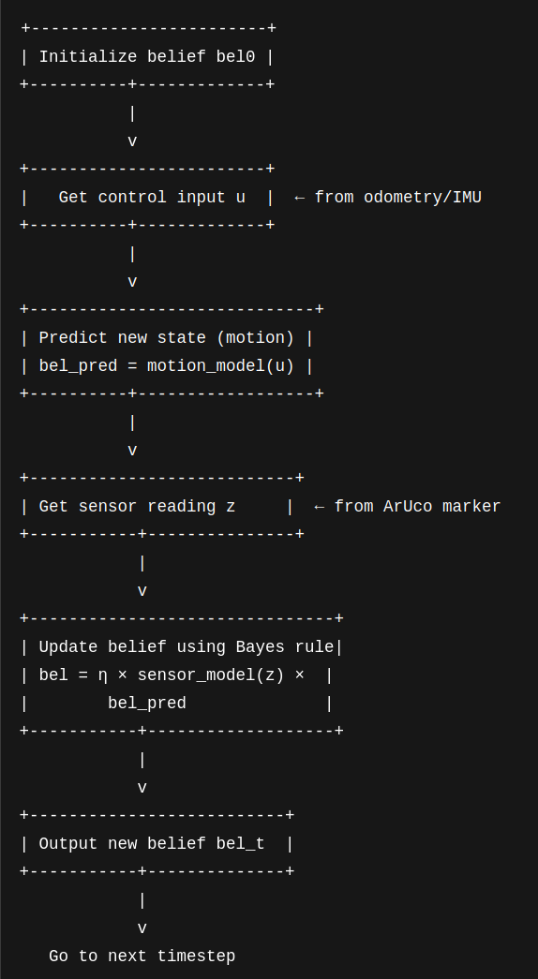
Bayes Filter based sensor fusion
Predicts the current state using a motion model based on previous state.
Updates belief by incorporating new sensor measurements using Bayes' rule.
Maintains a probability distribution over all possible states.

Slide 5
Kalman filter based sensor fusion
A mathematical algorithm for estimating the state of a dynamic system which works with noisy or uncertain measurements
Commonly used in robotics, navigation, and signal processing
Predicts current state using previous state and system model, and corrects prediction using new sensor data, weighted by uncertainty
Combines multiple sensor inputs to estimate system state
Reduces noise and measurement error
Produces a more accurate estimate than any single sensor

Slide 6
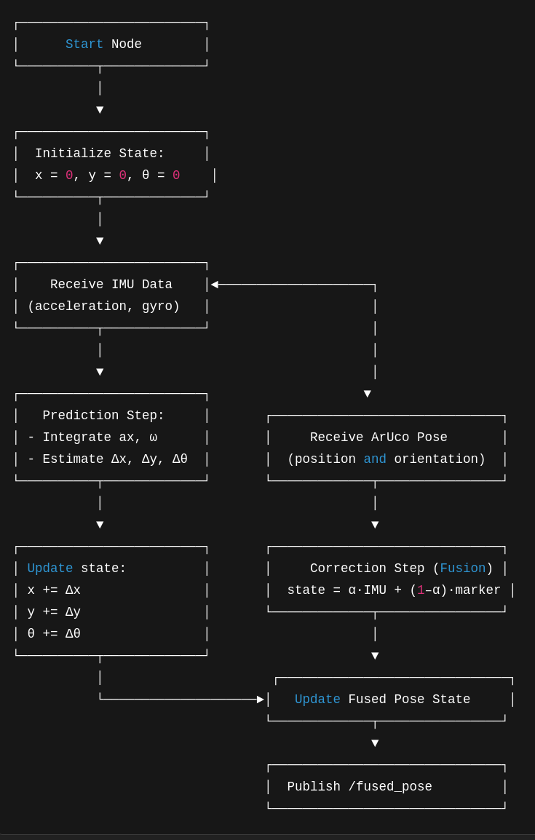
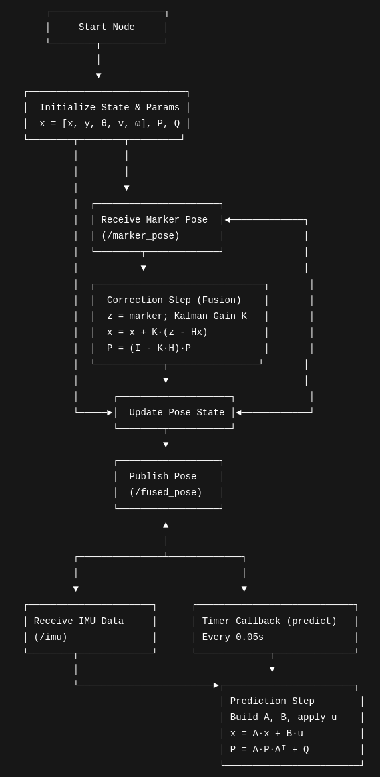
Method 1: Using IMU and ArUco based sensor fusion
Bayesian Filter
Kalman Filter

Slide 7
Method 1: Using IMU and ArUco based sensor fusion
Use the /imu ROS 2 topic to access linear acceleration and angular velocity from the IMU sensor.
Treat ArUco markers as fixed landmarks with known real-world coordinates.
Estimate the robot’s position in the world frame using relative pose information from ArUco marker detections.

Slide 8
Issues with IMU
The IMU sensor exhibited significant noise.
This noise caused unnecessary drift, even when the robot was stationary.
To address this issue:
We attempted live calibration using dedicated calibration nodes.
We tried correcting the gravity components leaking into the X and Y axes.
We also applied a low-pass filter directly to smooth the data.
While these steps led to slight improvements, the sensor data remained too unstable for accurate localization.
We concluded that an additional sensor would be required—used alongside the IMU—to provide more stable and reliable measurements for the localization algorithm.

Slide 9
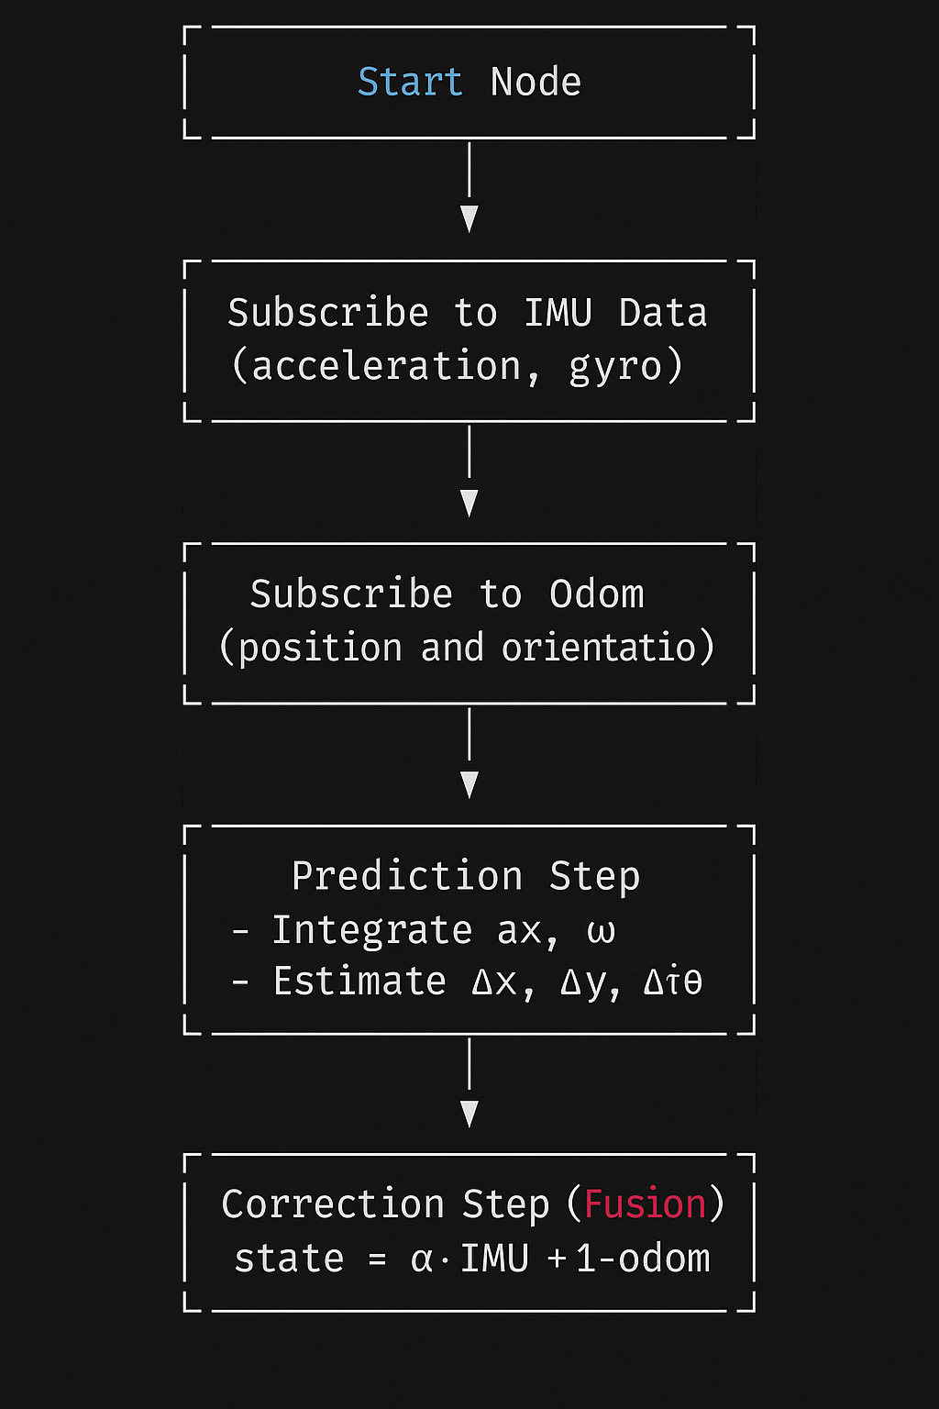
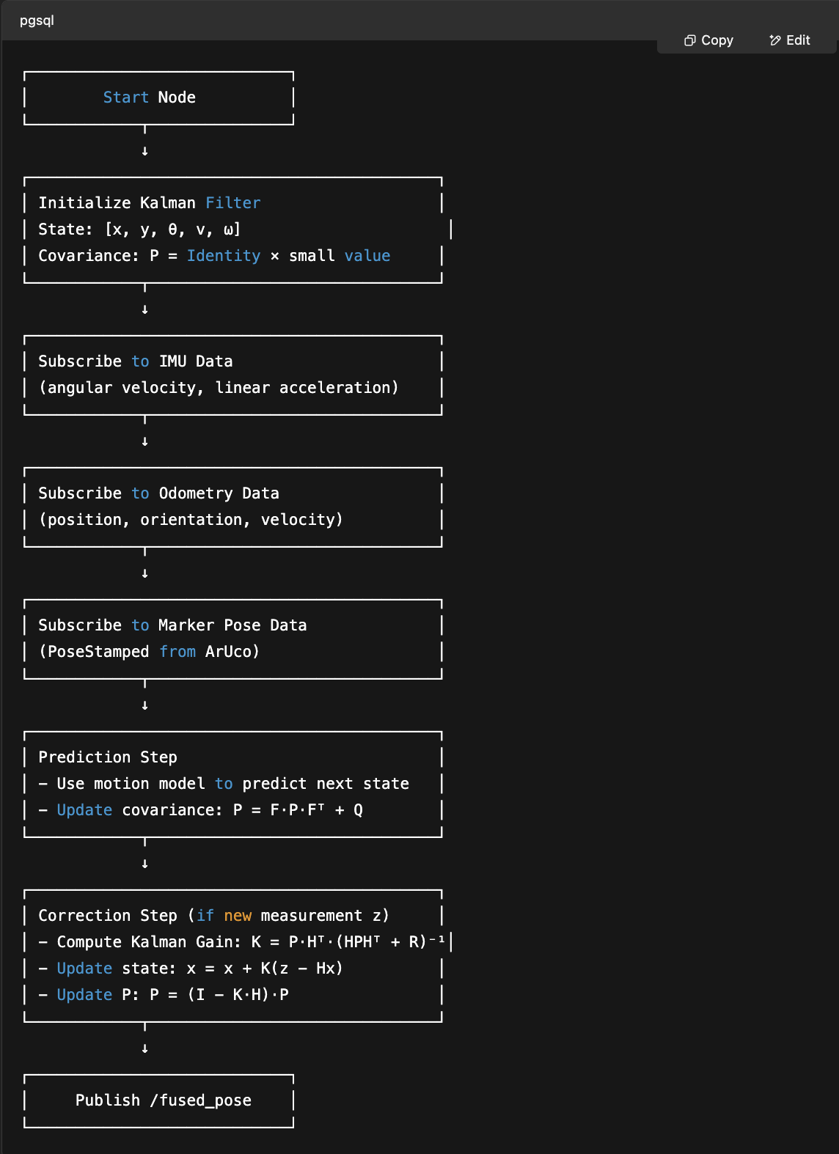
Method2: Using IMU, Wheel Encoders and ArUco markers
Bayesian Filter
Kalman Filter

Slide 10
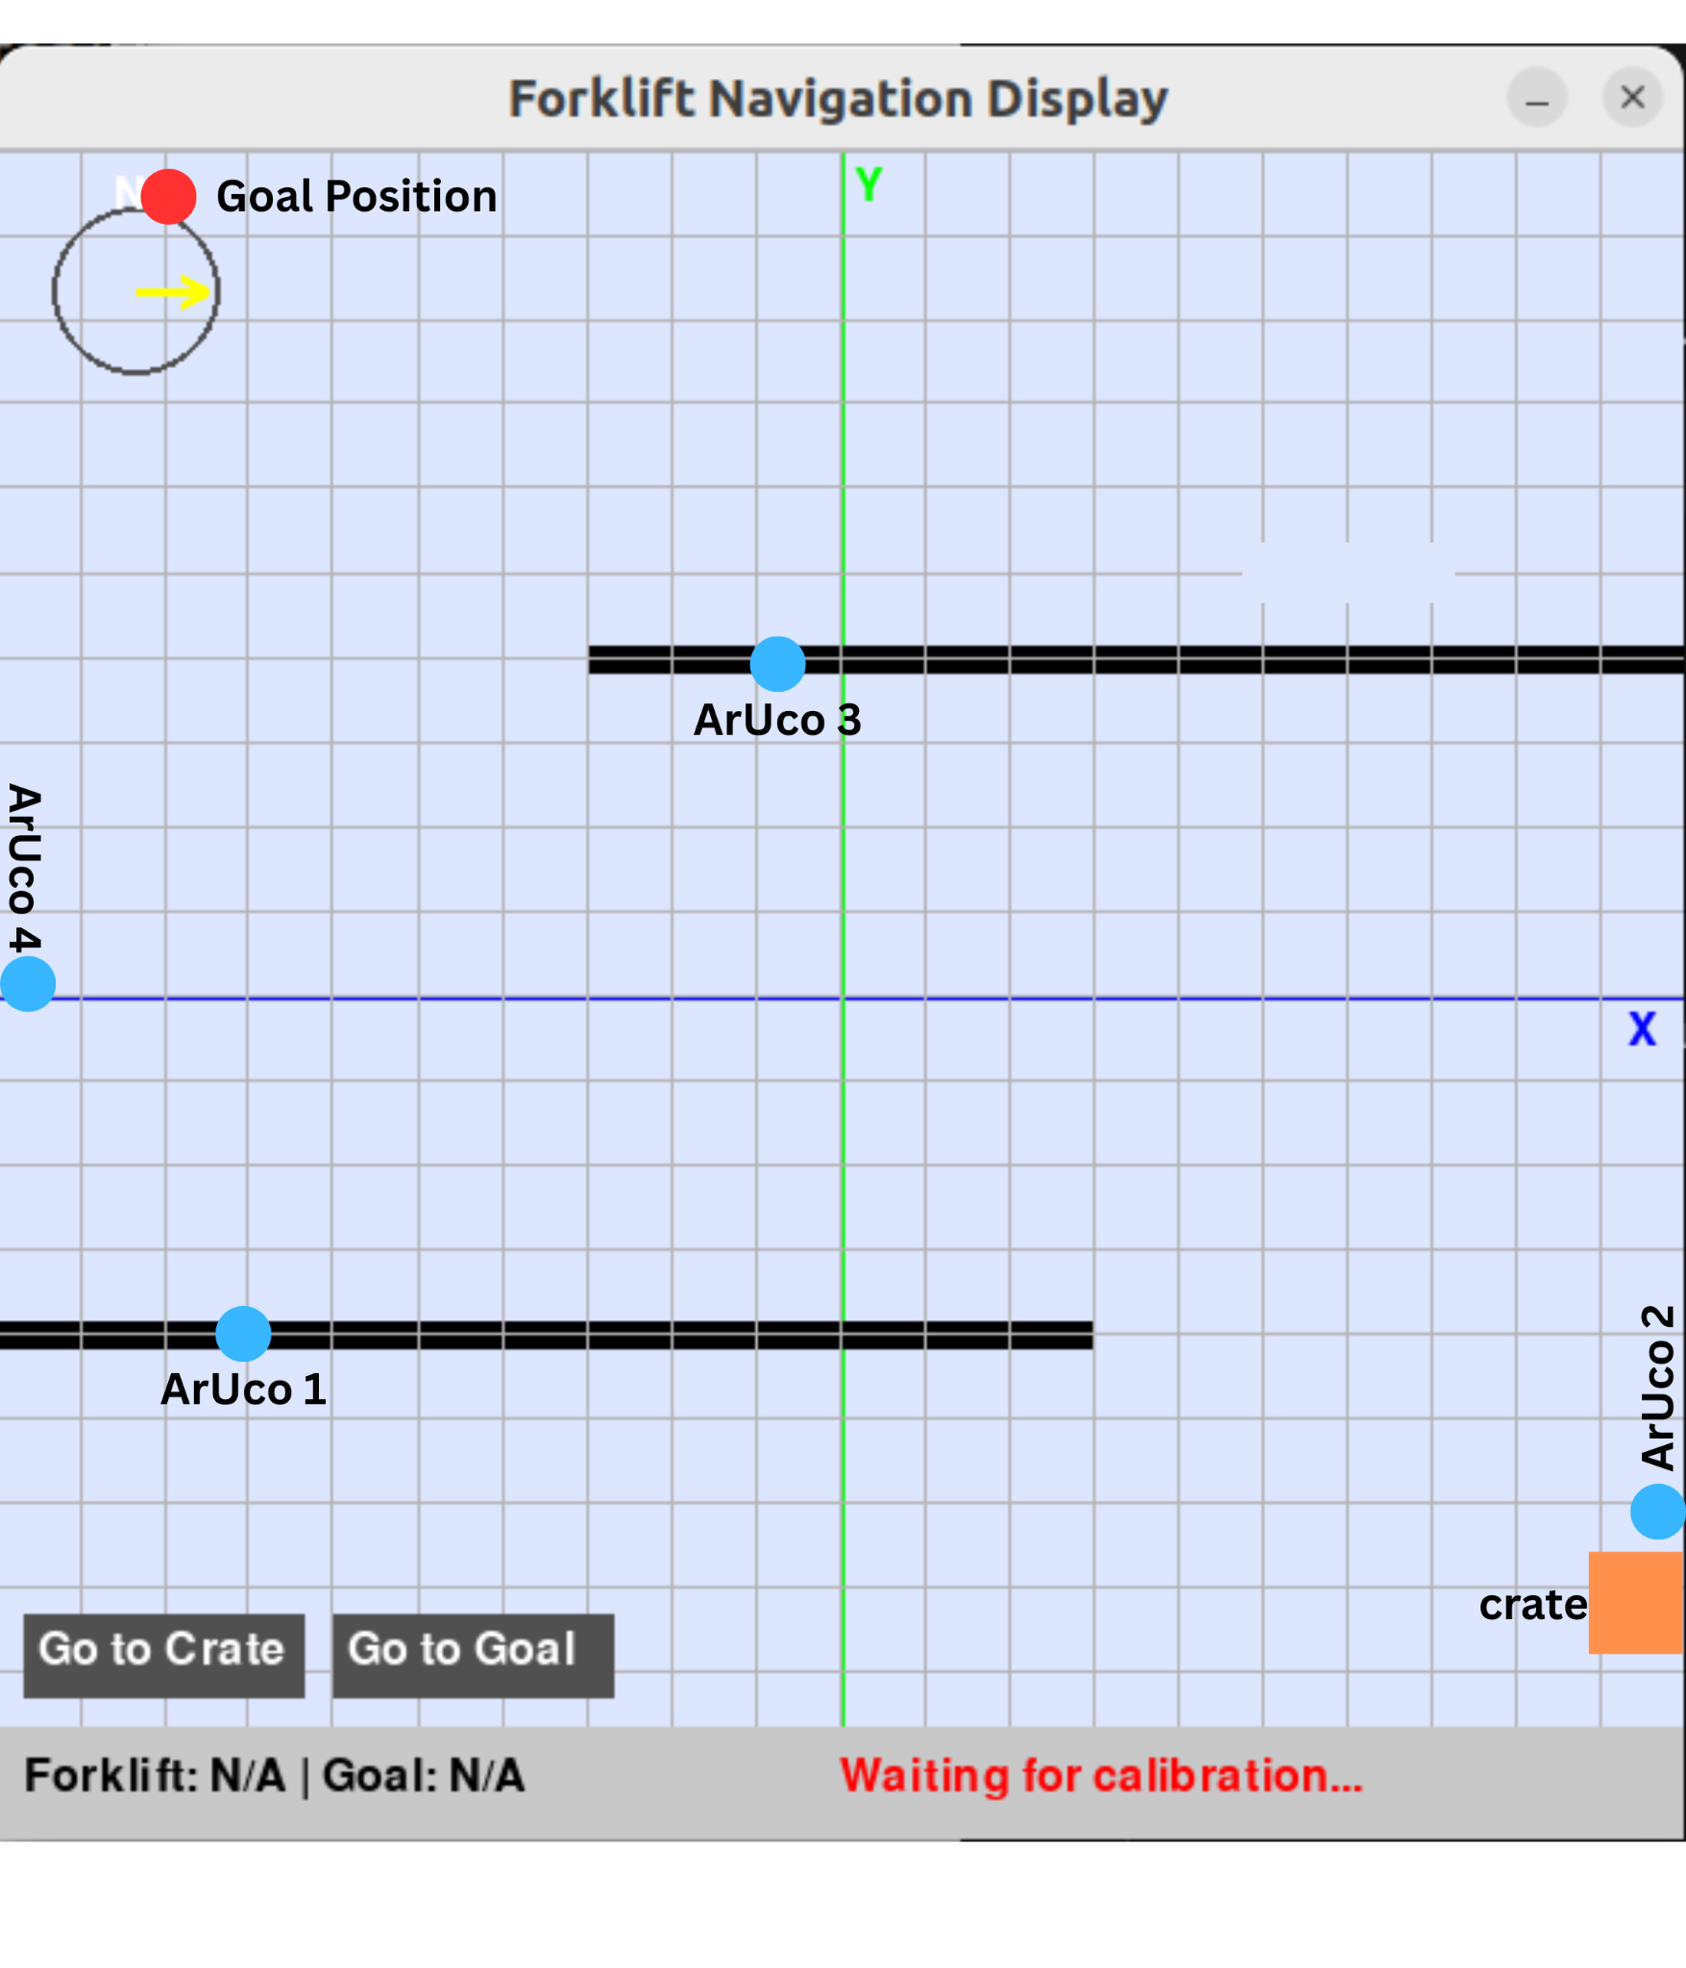
Forklift Display
First ArUco Detection for calibration
Button to get the path to the CRATE
Button to get the path to the GOAL

Slide 11
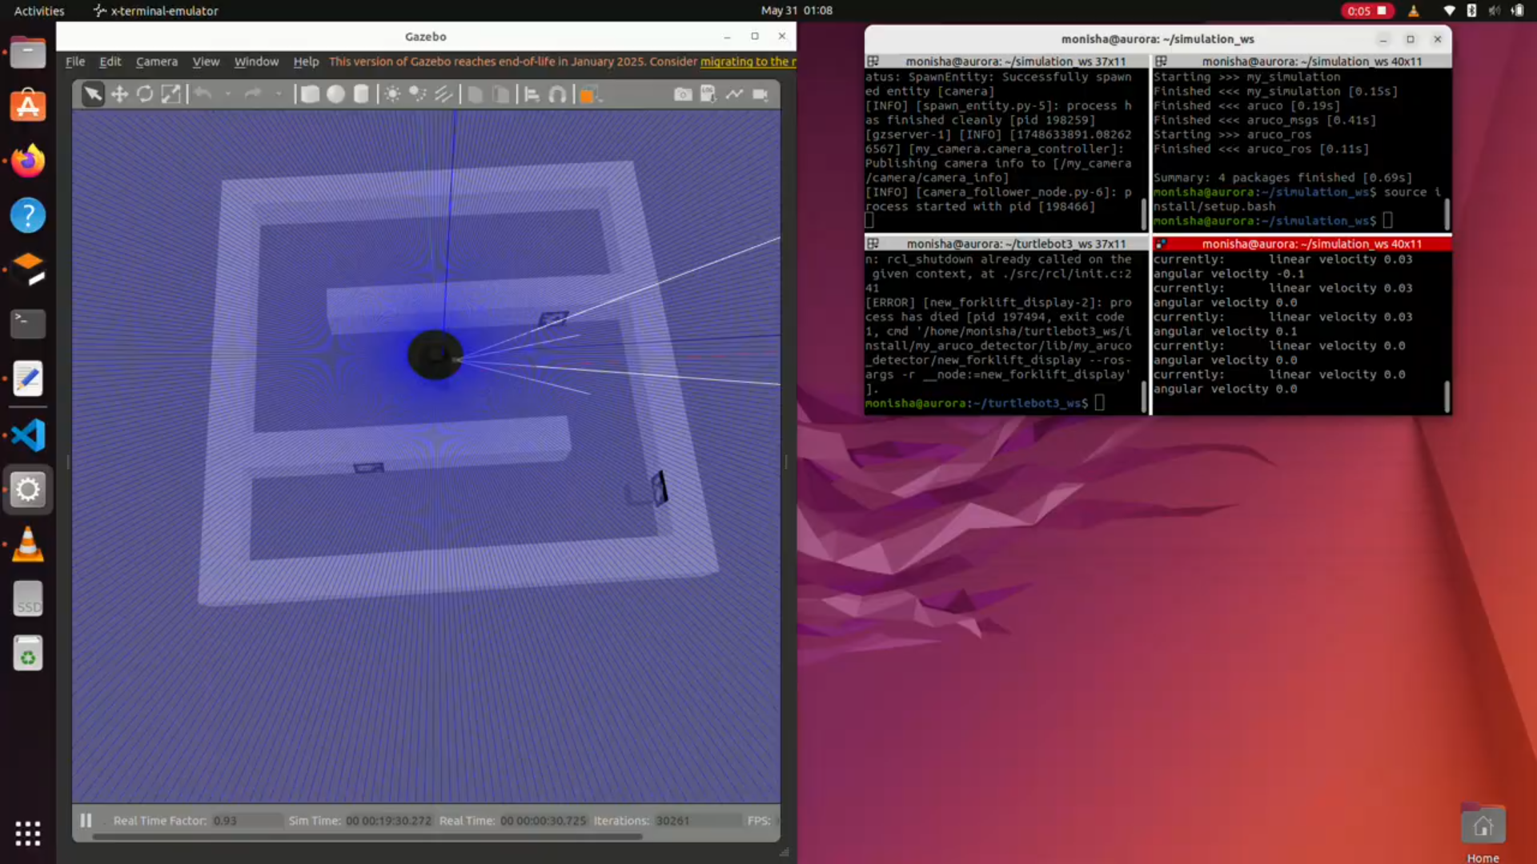
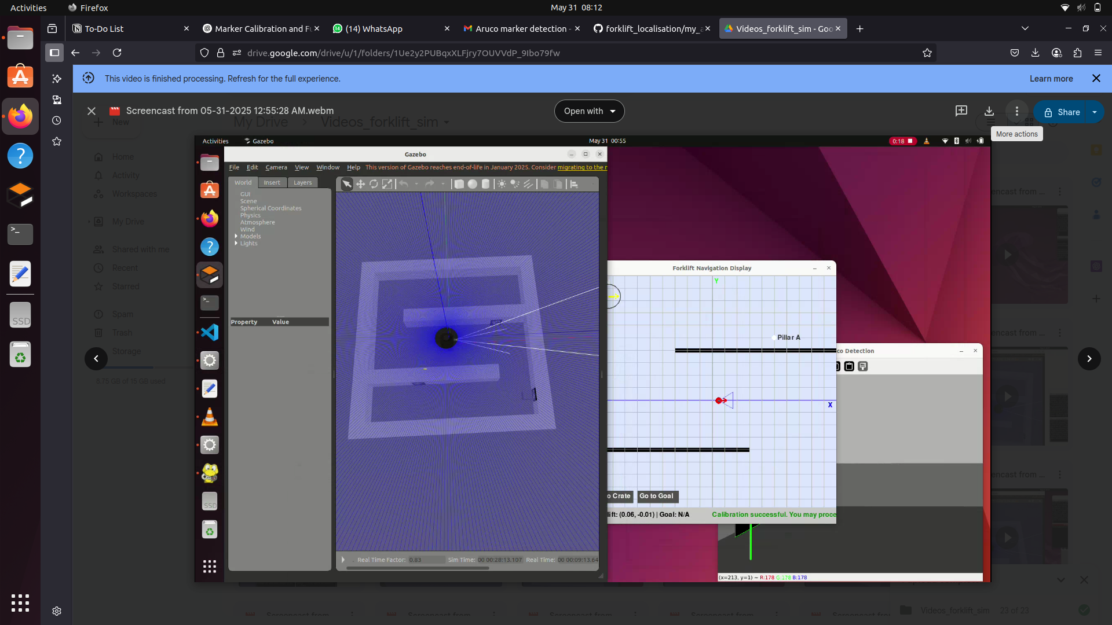
Gazebo Simulation
Arena setup in the simulation (gazebo)
Simulation setup with the full algorithm running

Slide 12
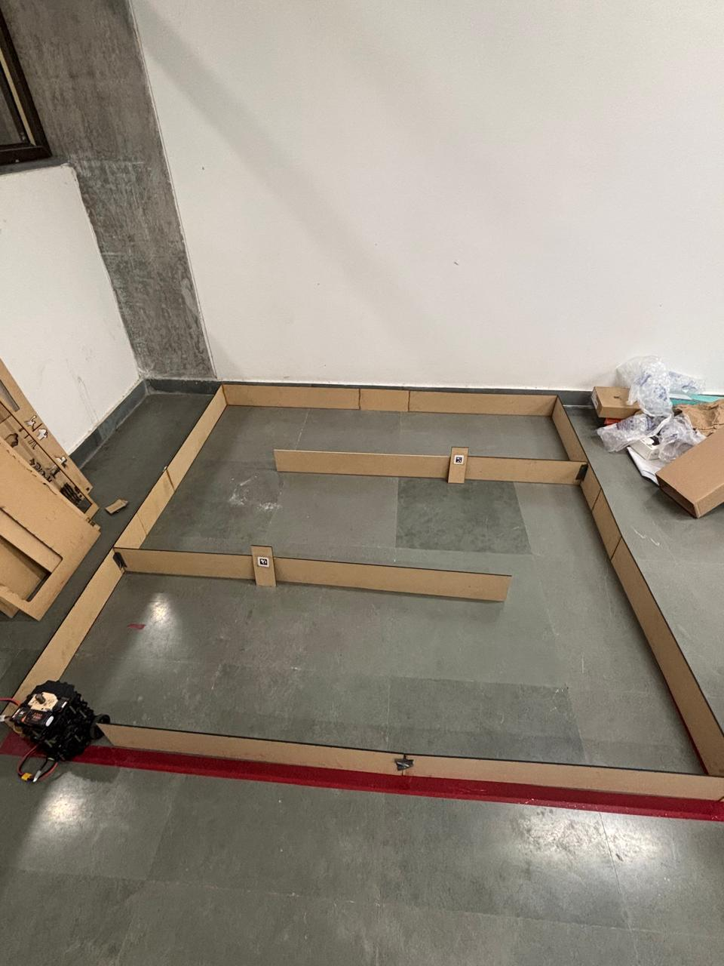
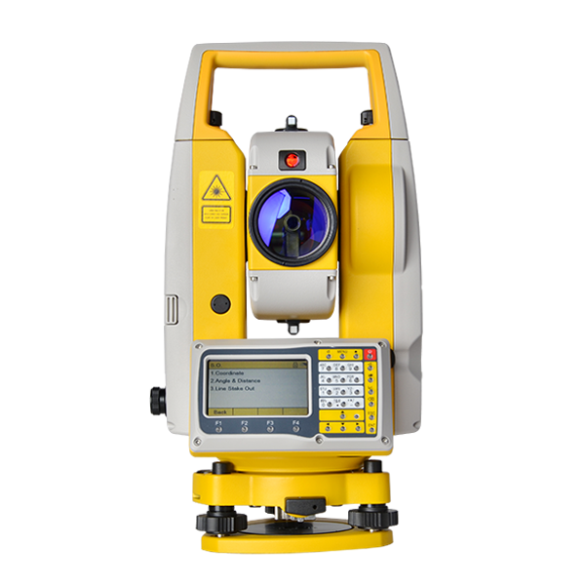
Real World Testing
Total station used for ground truth evaluation
Arena setup.

Slide 13
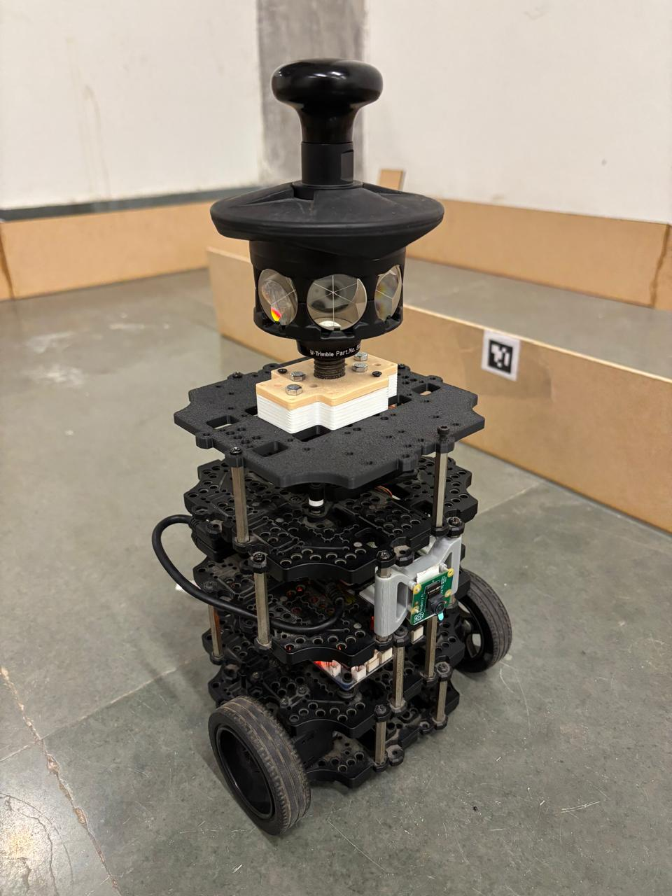
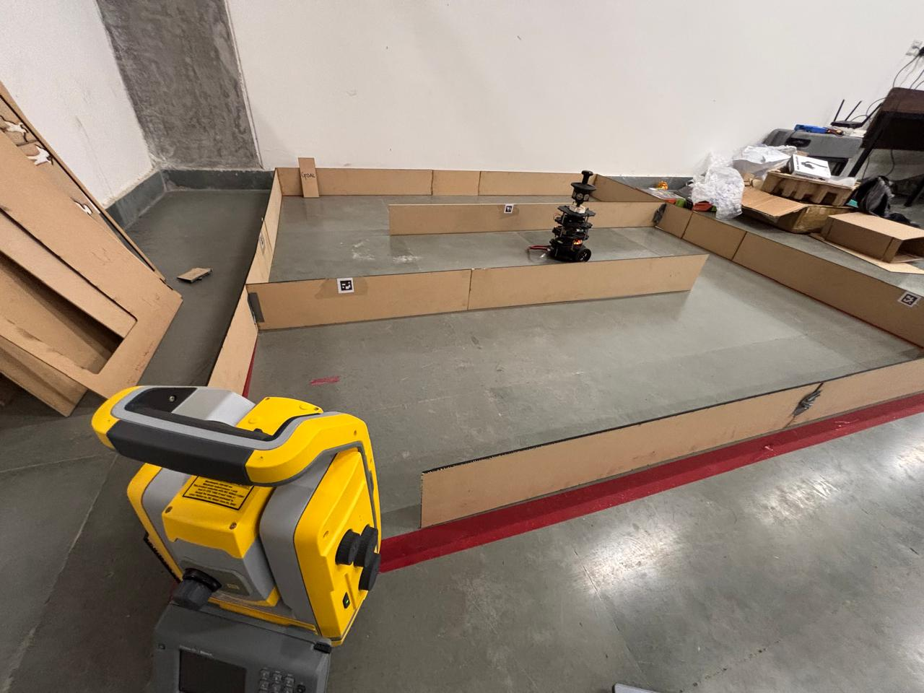
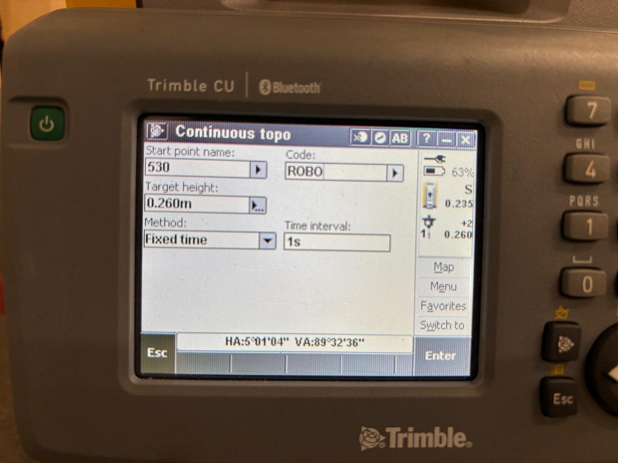
Real World Testing
Prism used for continuous tracking
Total station tracking at an interval of 1 second
Arena setup with Total Station

Slide 14
Ground truth evaluation using total station
A total station was used for evaluation of Ground Truth and Error estimation for each algorithm for each of the tested sensor combinations
The origin and axes were set in the total station
Continuous tracking was used, and the derived readings were then used for error estimation, to determine the accuracy of each algorithm

Slide 15
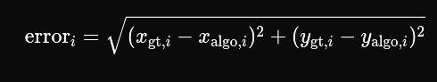


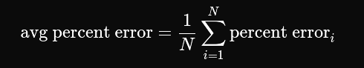
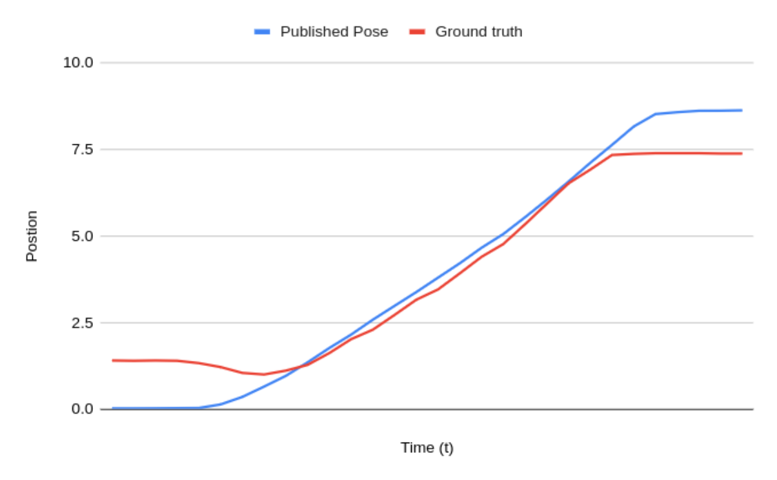
Ground truth evaluation using total station
Sensors Used | Algorithms Used | Percent Error using Ground Truth Evaluation
IMU sensor + ArUco Marker (Camera detection) | Simple Bayesian Filter | 13.71302323
IMU sensor + Wheel encoders + ArUco Marker (Camera detection) | Linear Kalman Filter | 5.220225946

Slide 16
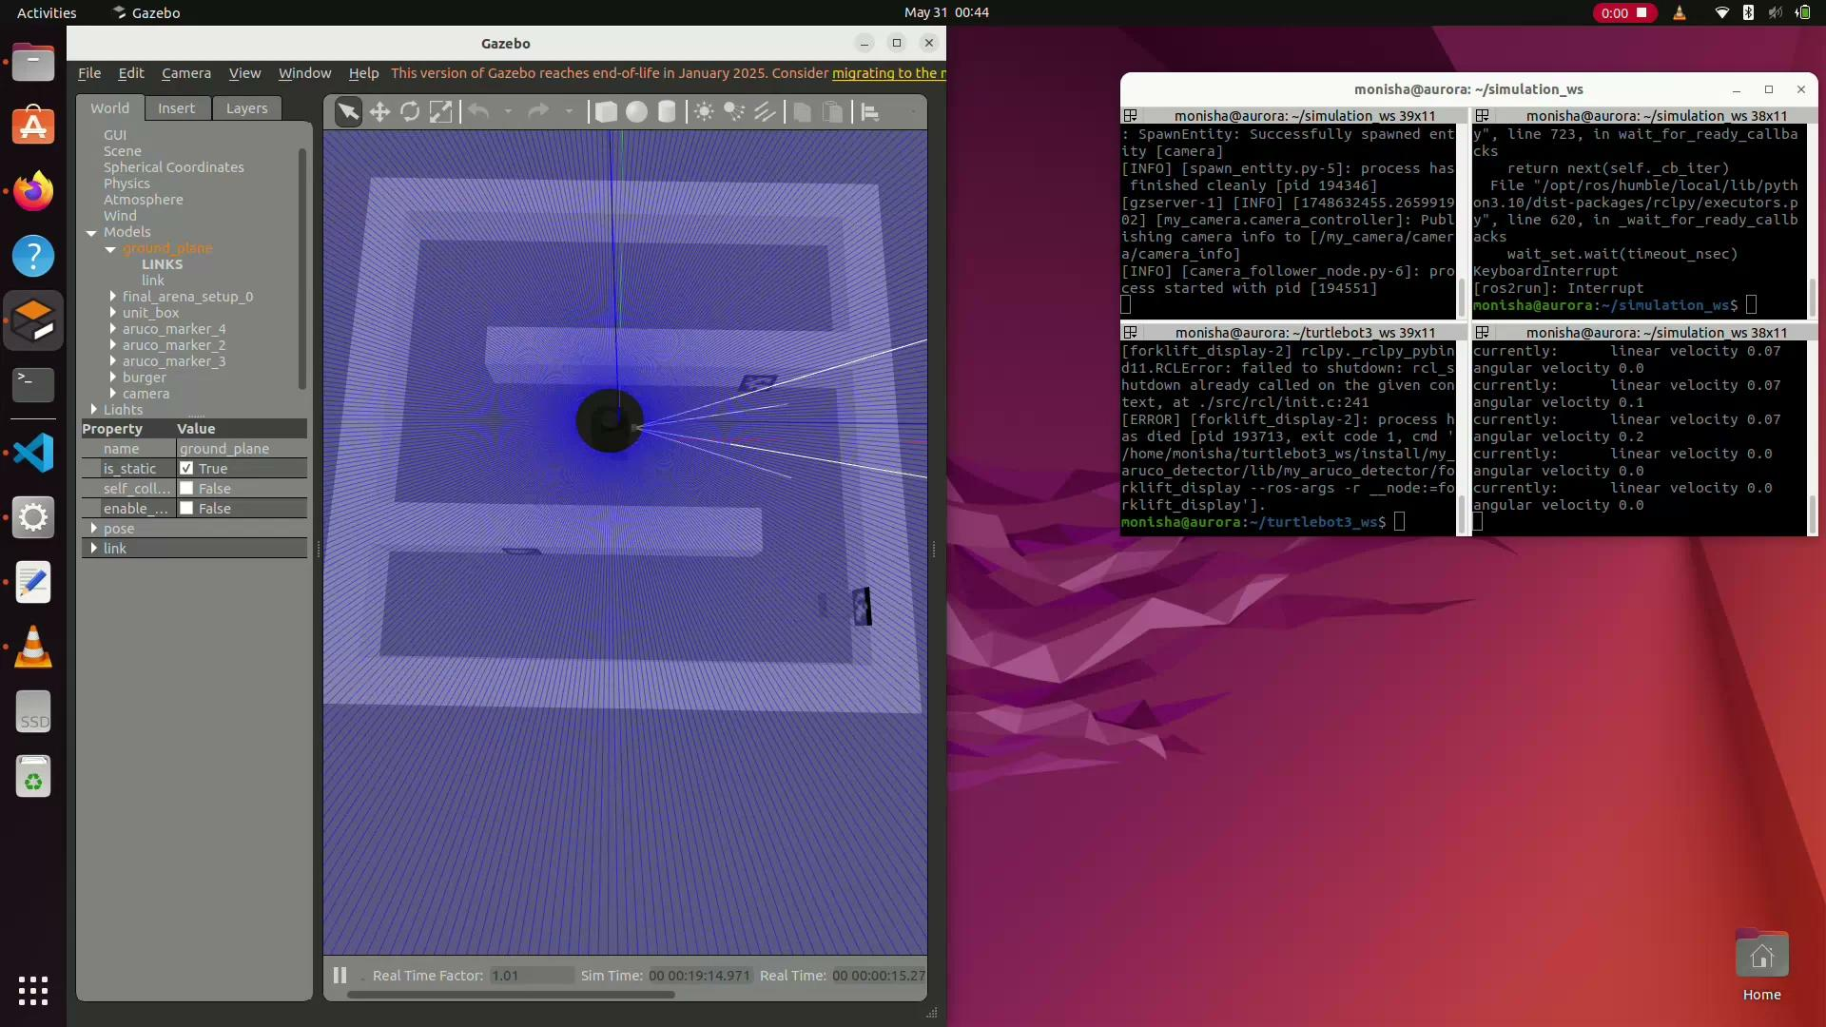
Media (Simulation)
Bayes filter on IMU + Aruco

Slide 17
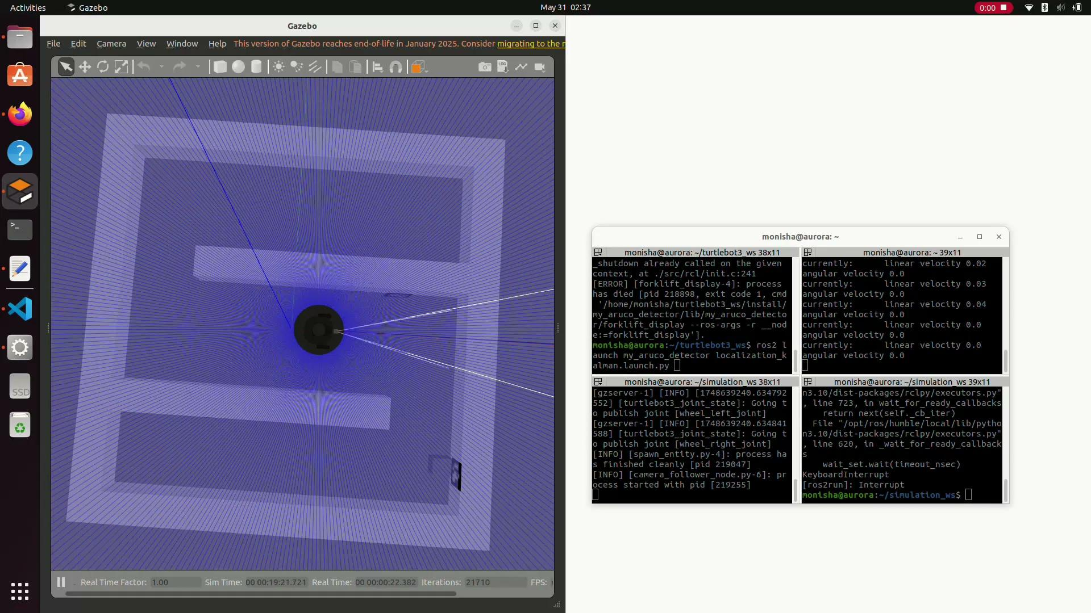
Media (Simulation)
Kalman filter on IMU + Aruco
(Overcorrection)

Slide 18
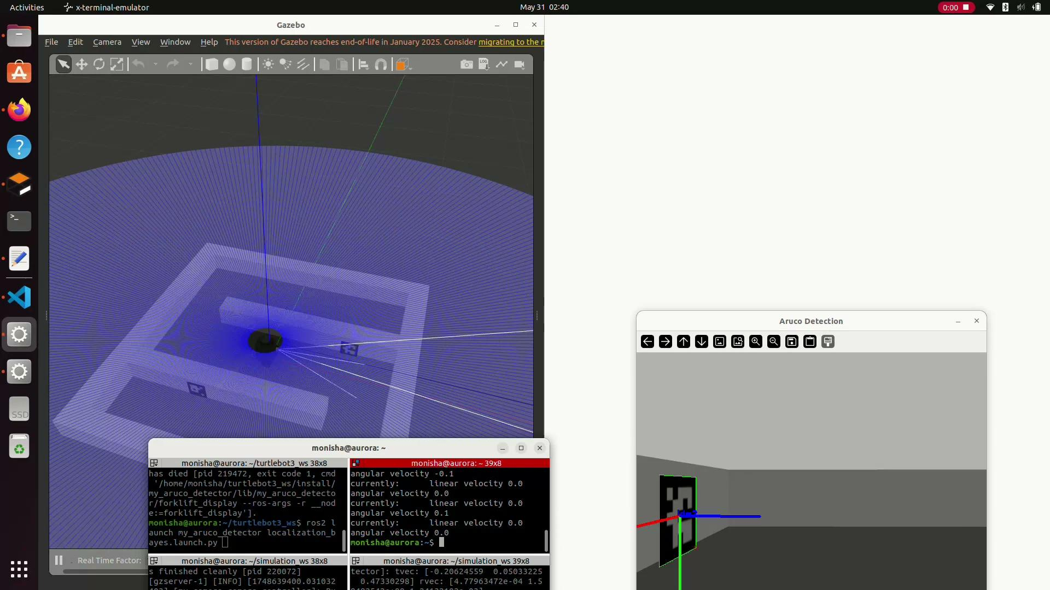
Media (Simulation)
Bayes filter on IMU + Wheel Encoder + Aruco

Slide 19
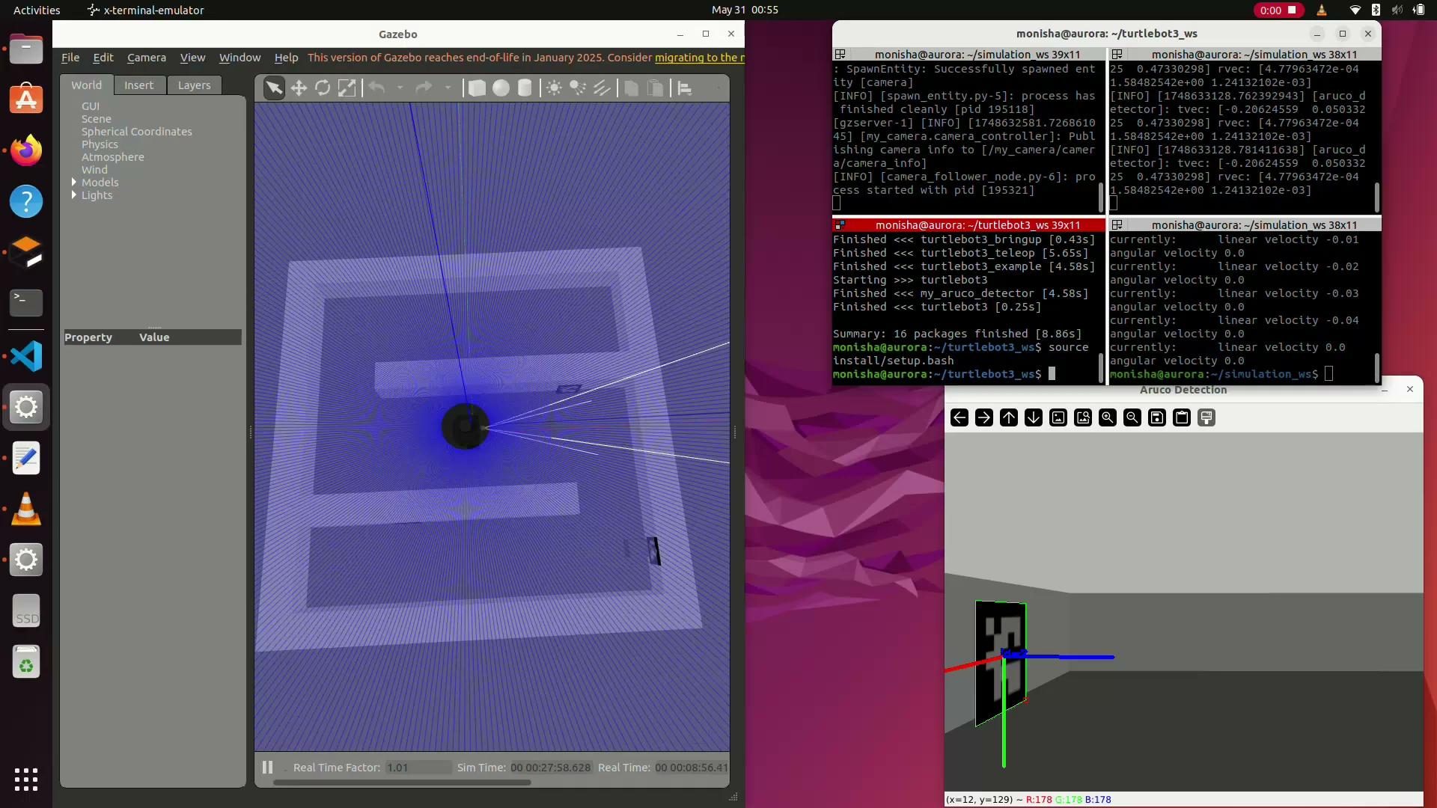
Media (Simulation)
Kalman filter on IMU + Wheel Encoder + Aruco

Slide 20
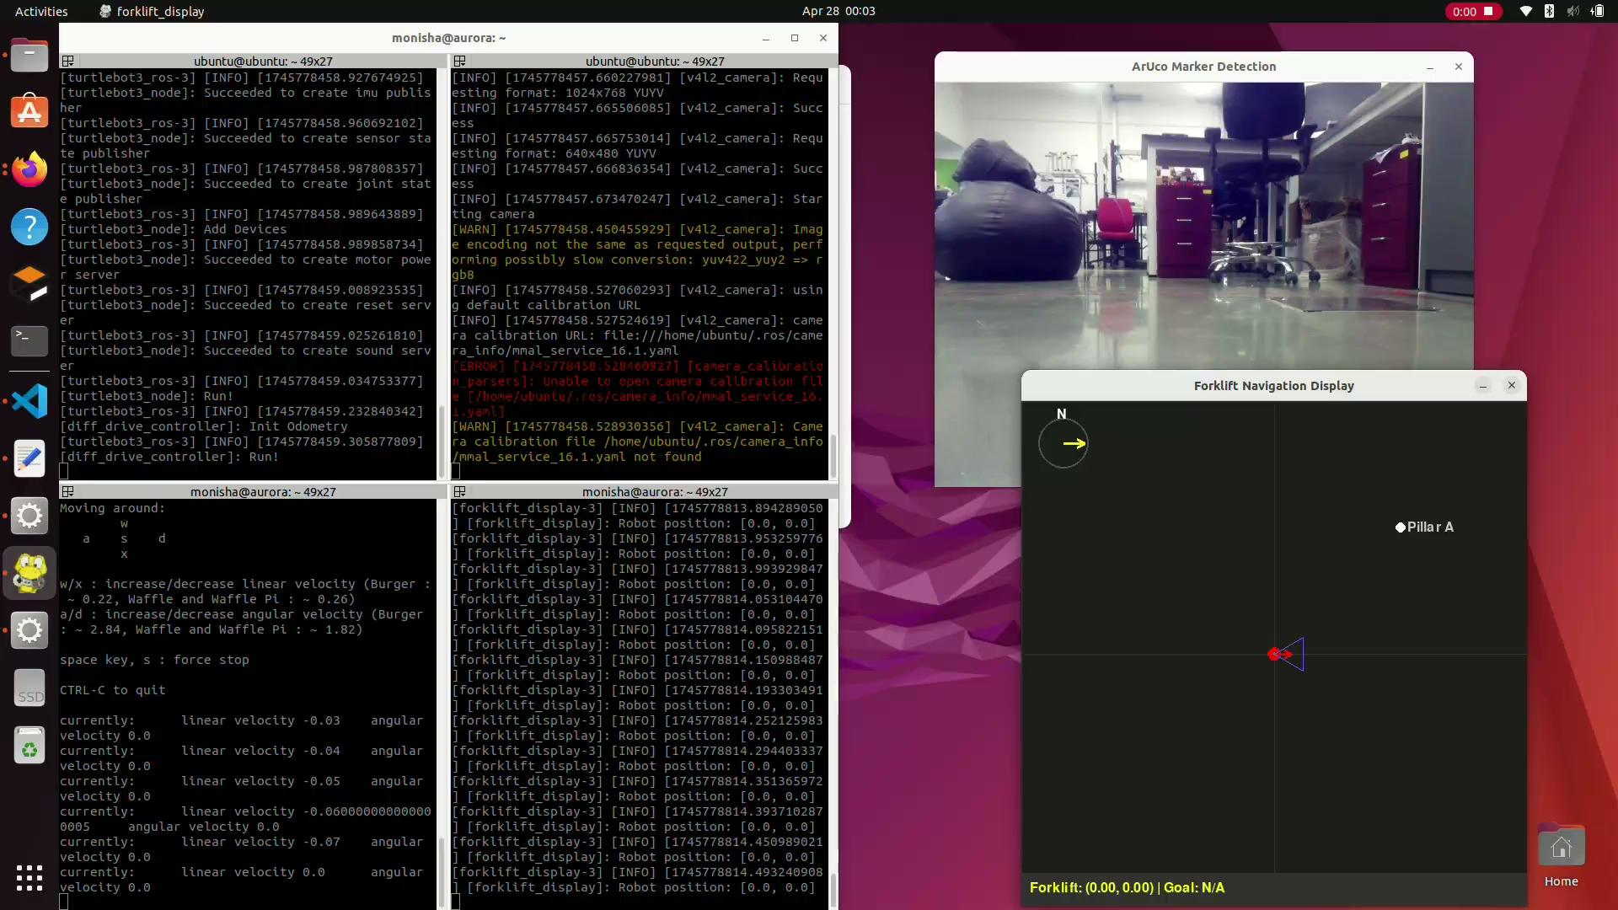
Media (Hardware)
Bayes filter on IMU + Aruco
Corrected imu data, with substantial drift upon going backwards

Slide 21
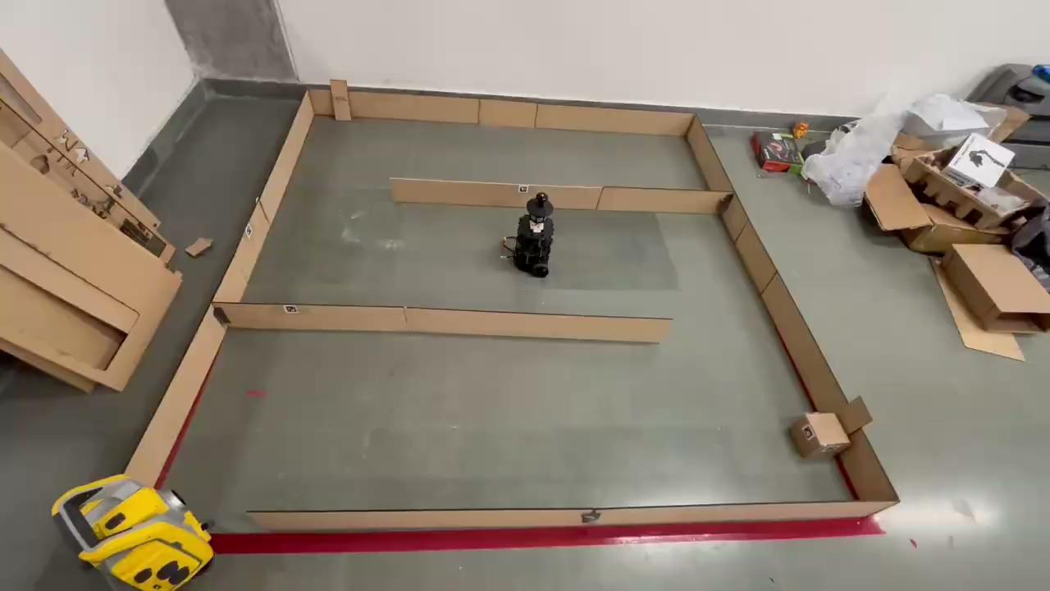
Media (Hardware)

Slide 22
Conclusion
As discussed earlier due to extreme noise from the IMU (due to various factors), relying on it solely is not advisable. (major fluctuations + drift)
Kalman Filter gives better output than Bayesian Filter in both the scenarios
Due to the small size of the arena (2m x 2m), and slow speed of TTB (max. 0.2m/s), noise is way too significant (upon some filtering of the data, could be better in a large open environment)
Proposed solution based on the experiments performed:
IMU + wheel encoders + AruCo Markers for correction, with a KF implementation

Slide 23
Alternative Solutions
Relying solely on the IMU + Aruco with the help of an AruCo marker grid placed throughout the warehouse
Basic mapping + implementation with a lidar + IMU+ AruCo detection
A more reliable and expensive IMU
IMU alone is not reliable (backed by research)

Slide 24
Potential Improvements
Testing more rigorous methods of noise elimination from IMU
Testing out with a more expensive IMU
AruCo marker grid
Improving the localization from AruCo marker (make it more reliable)
Lidar + IMU tests (would need some level of mapping using Nav2)
Improving the user interface, for smoother operation

